Slide 1
UNIT III
MEASURES & QUALITY
P.Ramya, Assistant Professor,Department of IT,VRSEC.

Slide 2
MEASURES AGENDA
Overview of measures:
    Why are measures needed? Control & monitor & Transparency
    Mapped to goal
    Should not affect other measures
    Who decides what is measured?
    Customer, development team and organization
    What should be measured?
    When are the measures taken?
    Daily, iteration, release
    How are the measures taken?
    Tracker, tester, user evaluator
    Who takes the measures?
    All the team members (role)
    How are the measures used?
2. Monitoring a Large-Scale Project by Measures
    Measure Definitions
    Measure Illustration
3. Measures in Learning Environments
P.Ramya, Assistant Professor,Department of IT,VRSEC.

Slide 3
What Is A MEASURE?
What Is A MEASURE IN SOFTWARE ENGINEERING?
How the measures are different for hardware products and software products?
P.Ramya, Assistant Professor,Department of IT,VRSEC.

Slide 4
GET ANSWERS TO THESE QUESTIONS
Why are measures needed?
To control &monitor, Know the characteristics of measures.
Who decides what is measured?
Customer, Management people, Development team
What should be measured?
Any thing that should be measured w.r.t to product / process
(Prodct size, quality, pulse,burn-down,faults)
When are the measures taken?
May be each day , each iteration or each release
P.Ramya, Assistant Professor,Department of IT,VRSEC.

Slide 5
GET ANSWERS TO THESE QUESTIONS
How are the measures taken?
The data required to measure is collected from the role
representatives (Tracker)
Who takes the measures?
All the team members
How are the measures used?
Should be evaluated against project goals.
Already determined measures can be adapted, if necessary.
P.Ramya, Assistant Professor,Department of IT,VRSEC.

Slide 6
Large-Scale Project by Measures
Product Size : To know the amount of work completed
Pulse :To measure the continuous integration
Burn – down :To present the project’s remaining work Vs the remaining human resources
Planning table-
Hr table
Faults: To count the faults per iteration
P.Ramya, Assistant Professor,Department of IT,VRSEC.

Slide 7
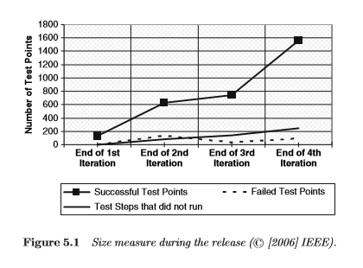
Product Size
P.Ramya, Assistant Professor,Department of IT,VRSEC.

Slide 8
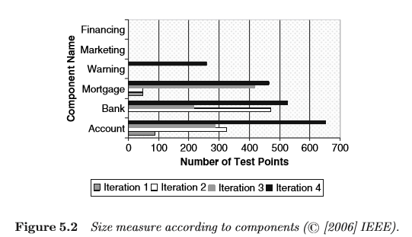
Product Size
P.Ramya, Assistant Professor,Department of IT,VRSEC.

Slide 9
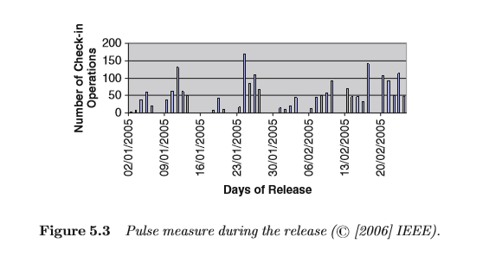
Pulse
P.Ramya, Assistant Professor,Department of IT,VRSEC.

Slide 10
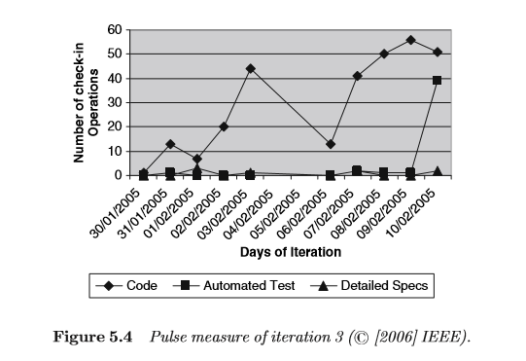
Pulse
P.Ramya, Assistant Professor,Department of IT,VRSEC.

Slide 11
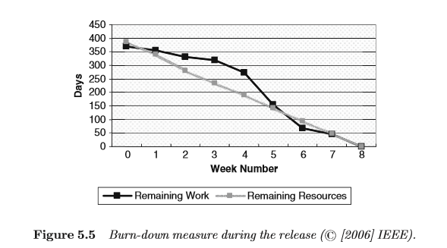
Burn - Down
P.Ramya, Assistant Professor,Department of IT,VRSEC.

Slide 12
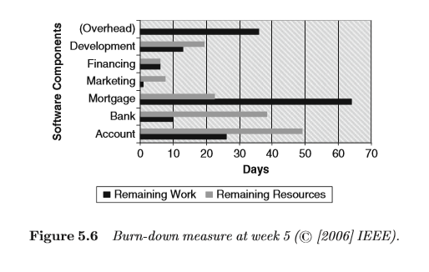
Burn - Down
P.Ramya, Assistant Professor,Department of IT,VRSEC.

Slide 13
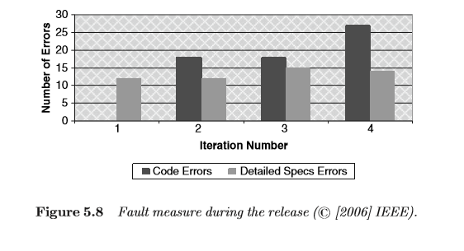
Faults
P.Ramya, Assistant Professor,Department of IT,VRSEC.

Slide 14
Measures in Learning Environments
1. Teaching & Learning Principles:
Emphasize the software development approach in the context of the World Software Development.
2. Measurement Activities:
  Define Measures
  Decide on how to collect the relevant data
  Analyze and Present the measure
  Assess the project status by using the measures
  3.. Role – Based Measures:
  Role time measures (dev role vs agile role)
  Role communication measure
  Role management measure
P.Ramya, Assistant Professor,Department of IT,VRSEC.

Slide 15
person | Time spent on dev | Time spent on role
a | 70 | 30
b | 60 | 40
c | 80 | 20
d | 50 | 50

